Slide 1
Challenge 1
Smart Meter Data

Slide 2
Challenge 1 – Smart Meter Data
The Challenge
Approach
Findings
Key Learnings

Slide 3
The Challenge
Analyse consumption data
Link consumption patterns
Create forecasting process
Smart Meters in London Dataset
Customer segments
Holiday intervals
Weather patterns
Scalable
Uses accuracy metric
Notes:
Initially started on own but requested to join team UnicorNN
Createing a clean dataset took 80% of time for this project

Slide 4
Our approach
Understanding
The challenge
Key objectives
Recommendations
Research
Literature
Available code for similar datasets
Notes:
Rationale of exploration rther than build a production model
Initially started on own but requested to join team UnicorNN
Createing a clean dataset took 80% of time for this project
Adrian interested in time series problems.
Forecasting – tried 15 model types, simple through complex
(RMSE) - consistent metric

Slide 5
Our approach
Data
created clean datasets
Training
Testing
Selected consistent metric for all forecasts
Notes:
Rationale of exploration rther than build a production model
Initially started on own but requested to join team UnicorNN
Createing a clean dataset took 80% of time for this project
Adrian interested in time series problems.
Forecasting – tried 15 model types, simple through complex
(RMSE) - consistent metric

Slide 6
Our approach
Tried many forecasting model types
Clustering – explored several methods.
Notes:
Rationale of exploration rther than build a production model
Initially started on own but requested to join team UnicorNN
Createing a clean dataset took 80% of time for this project
Adrian interested in time series problems.
Forecasting – tried 15 model types, simple through complex
(RMSE) - consistent metric

Slide 7
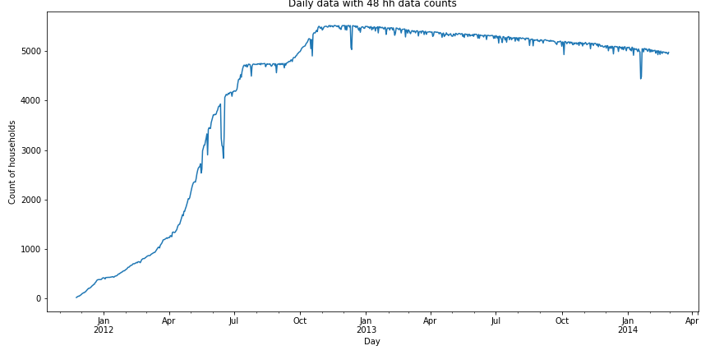

Half Hourly energy consumption
Household Acorn
UK Bank Holidays
Acorn Details
Combine,
Clean,
Sub-sample
Hourly weather information
Feature Generation
Notes:
Inconsistencies in data

Slide 8
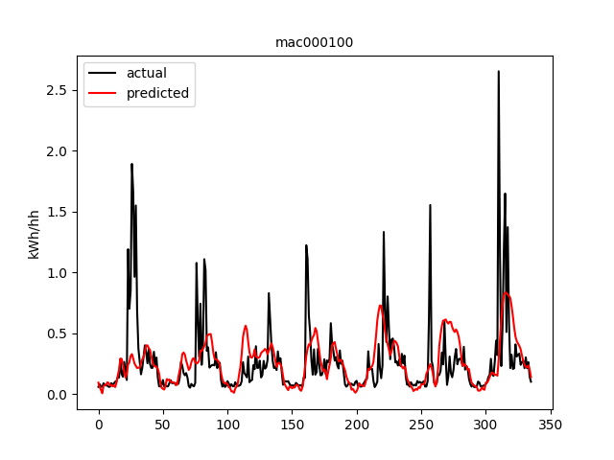
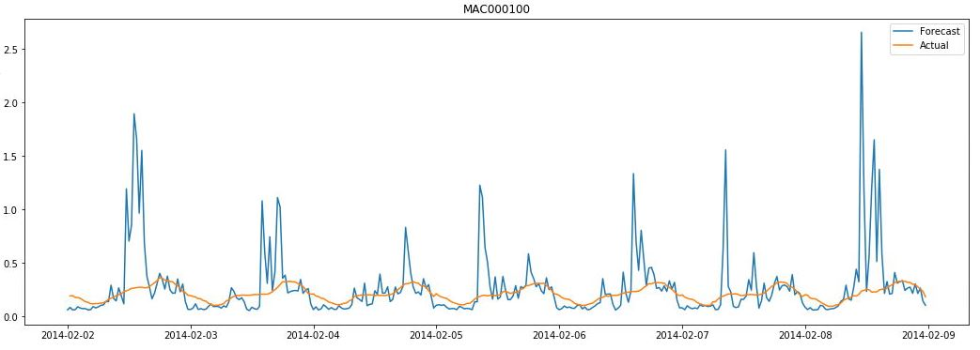
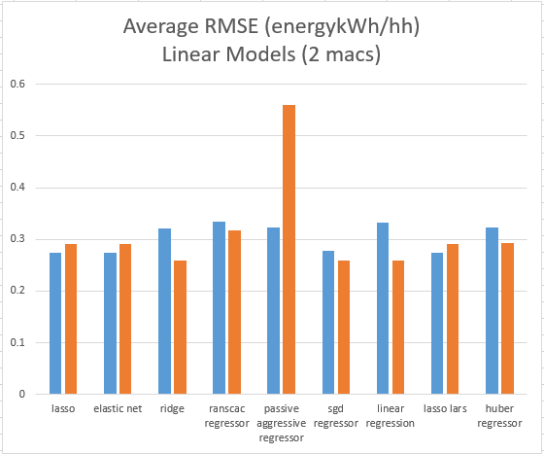
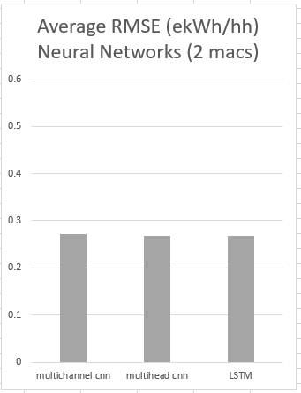
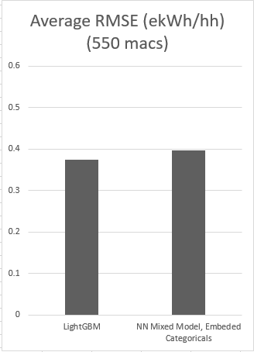
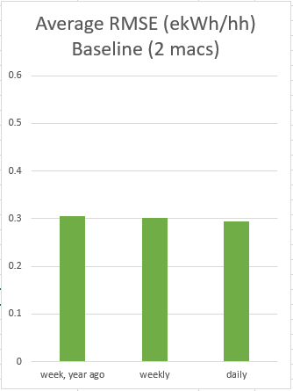
Actual
Forecast
Half hours
Notes:
24 individual models – train MAC by mac
2 models trained on 550 households (10%) of data
2 models trained on daily data
Several methods to reasonably
accurately forecast 7 days ahead

Slide 9
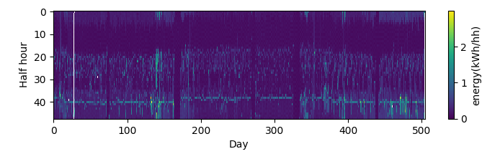
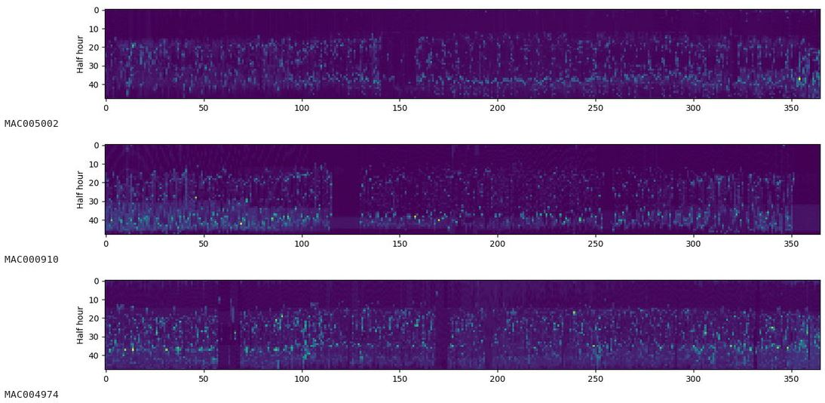
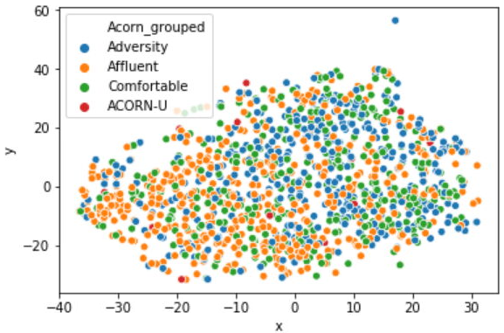
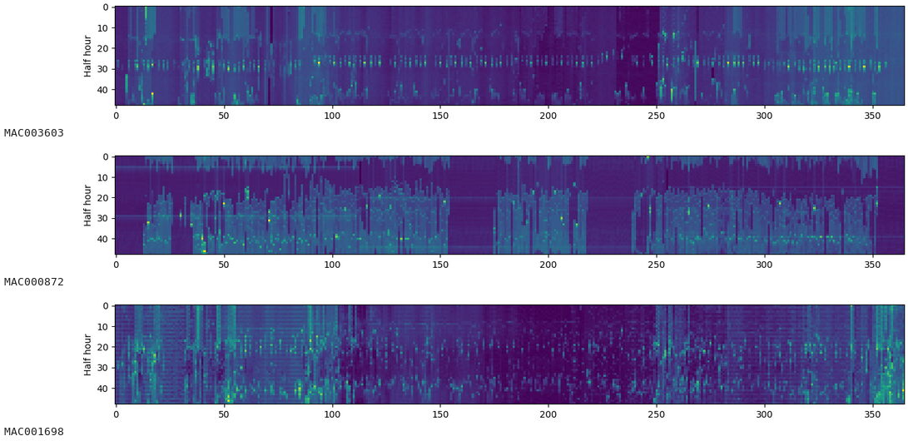
Notes:
A relationship between Customer groups and
consumption patterns

Slide 10
We learnt…
Generate a consistent dataset and metric for all forecasts
Look at forecast variance as well as accuracy (across many households)
Converting the energy consumption curves to images and using a Neural Network to cluster is relatively fast and is worth further exploration
Notes:
- break the data down into a manageable size as quickly as possible -
– build models on this, then run the workflows on the larger dataset.
Clustering large time series datasets using kNN and dynamic time warping
is very compute intensive

